Slide 1
MINING EQUIPMENT REPORT
Prepared By:
Wilhelmina Asihene

Slide 2
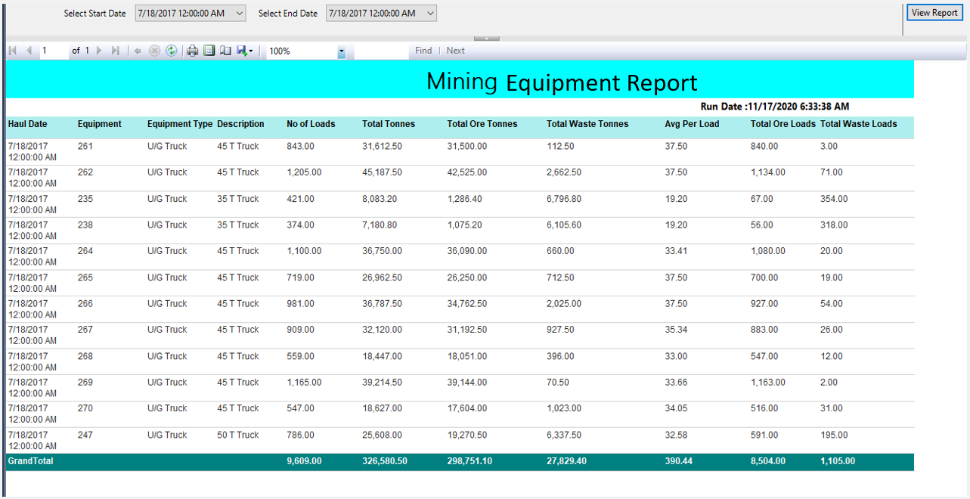

Slide 3
